Slide 1


Unit Testing

Slide 2

Intro
What is a test?
Code you write to verify the behaviour of your application
Why bother writing tests?
Tests are specifications for how our code should work.
Consistency
Tests help unify how our code behaves.
Comfort & Confidence
Guarantees the quality of your work.

Slide 3
Intro
Productivity
Allows to ship quality code faster
Cost Efficient
Helps find bugs early in the development cycle; by finding bugs early, you avoid costs in production.

Slide 4
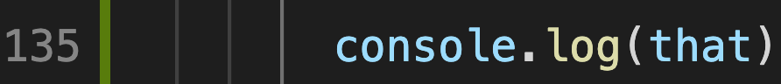
Intro
We all have written some sort of test:

Slide 5
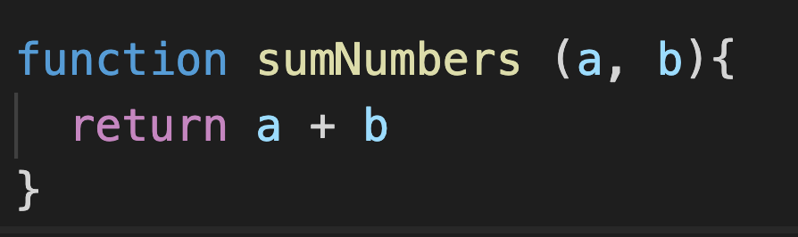
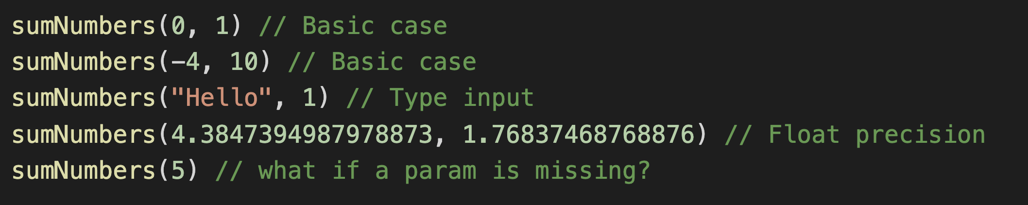
Intro
Or tested your functions by calling it with different parameters:

Slide 6


What Have I done so far?
Unit testing!

Slide 7
Problem
But these type of tests that we’ve written in our code have some problems:
They are not automated
They are mixed with our code
They can not be applied to other piece of code
They should run only at the request of a test (not in development)
They should be separated from production code

Slide 8
The solution
Repeatable tests stored in an organized structure
Script commands that will run those tests
Automatic checks on other platforms (Github can run them upon each push)

Slide 9
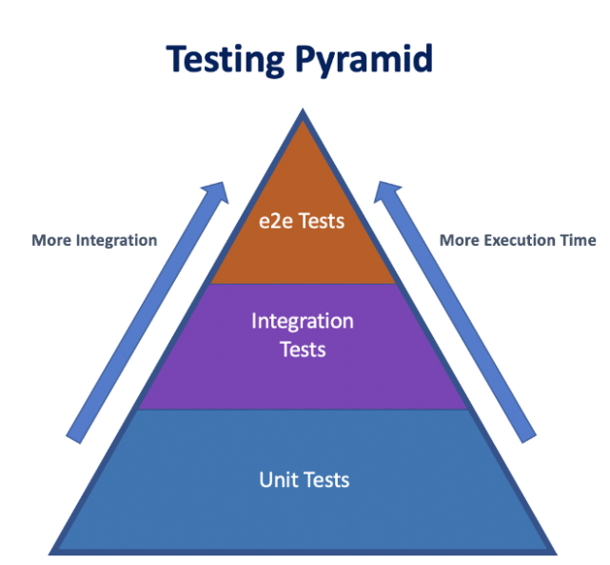
Types of Tests
👉

Slide 10
Types of Tests
Unit Testing: Unit tests only test a single part of your implementation. A unit. No dependencies or integrations, no framework specifics. Could be only a function or a component. Mostly done with
Integration Testing: Verify that multiple units work together: that your components communicate properly between them, or with a DB, file system or another third party. It could even be another module in your app. Individual units/features of the app are combined and tested as a group.
End to end testing: Test the flow of the application to make sure behaves as expected. The whole essence of end-to-end testing is to test from the end user’s experience

Slide 11



Tools
Jest: https://jestjs.io/
testing-library/react: https://testing-library.com/
React-test-renderer: https://reactjs.org/docs/test-renderer.html
Good news! You already know what a test suite looks like 🤩

Slide 12
Why Jest
Open source
Developed by Facebook (and so was React)
Compatible with the 3 main Front End Frameworks: Angular, React, VueJS.
Can test any program in JavaScript or TypeScript, no matter if it is a browser or NodeJS project.
Preferred for React-based website apps (comes as default with create-react-app).
One stone for everything: spies, matchers, huge mocking library.
Supports Typescript.
Supports Watch feature

Slide 13
Why Jest
TL;DR:
Battery included, almost zero configuration, testing framework and assertion library packed together
Runs fast. Watch Feature allows to re run only some of the tests.
Popular among different Front End frameworks
Unit testing is not about manually checking that each part of your code works. Is about having a trusty system that can certify the different units and replicate the results upon request.

Slide 14
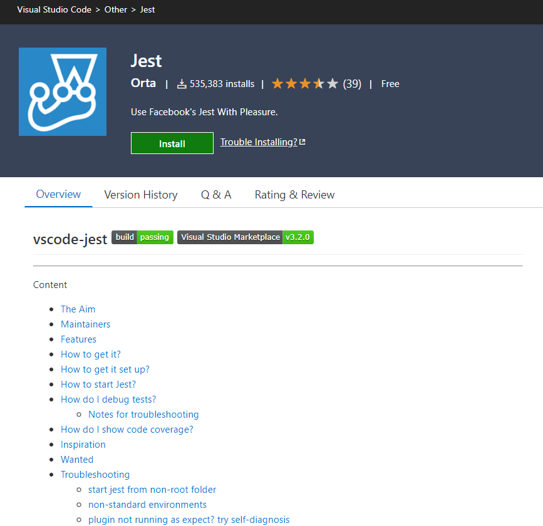
Jest and VSC Integration
https://marketplace.visualstudio.com/items?itemName=Orta.vscode-jest

Slide 15
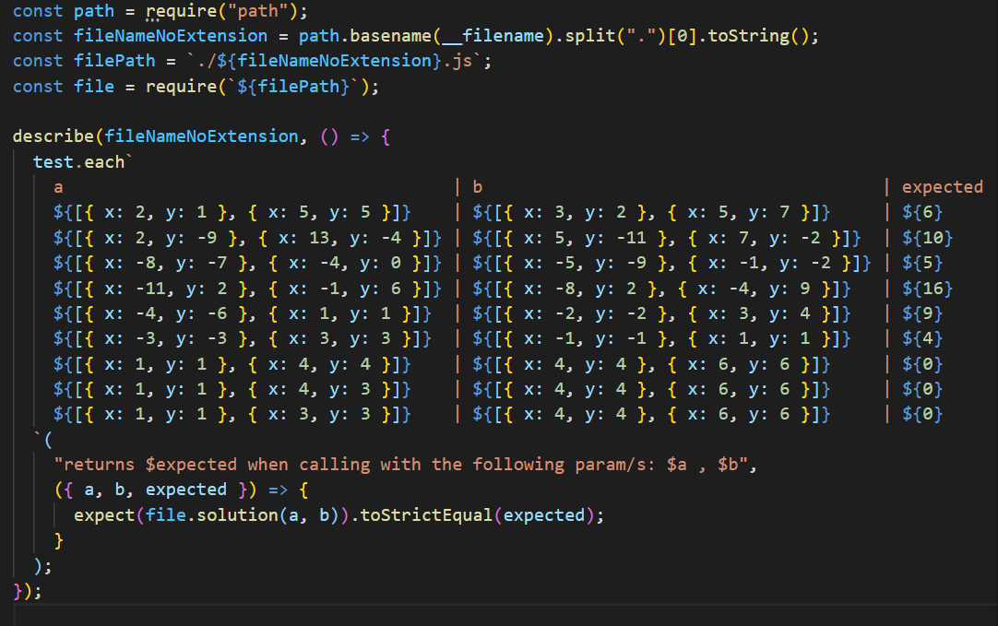

Test Driven Development (TDD)
You all already have seen a test suite: like the ones in the interview questions.
Some of you will remember -and some others never forget- overlappingRectangles or canExit among others.

Slide 16
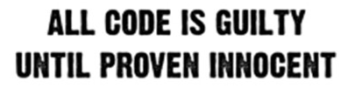
Test Driven Development (TDD)
You have been working with this workflow with the interview questions.
First you write the tests, then you write your code.

Slide 17
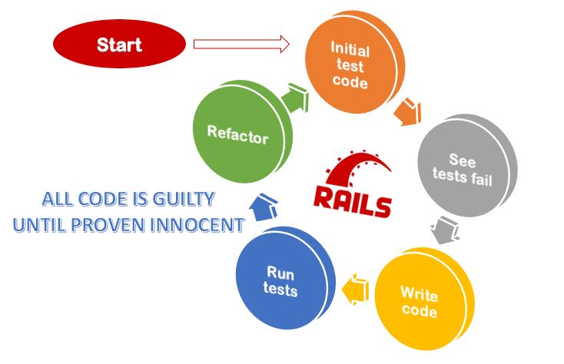
Test Driven Development (TDD)
Refactoring: Changing the code’s design without breaking existing functionality

Slide 18
Recapping
Tests ensure quality
Tests are your friends, they give specification
You have certain familiarity with tests, you have run them in the past
You have developed code under TDD

Slide 19
What can we test with Jest?
Basically, everything that you expect it to assert a result:
Return values from functions
Classes, what each instance looks like, their methods
Compare objects, results
React components
Connections to DataBases
API calls

Slide 20
Let’s start

Slide 21
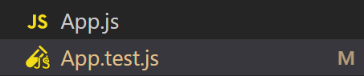
Rules for testing
Test files should be saved with the same filename that the element that they are testing, adding the suffix .test or .spec. In a close location to the file (same directory, or under a __test__ folder inside of it)

Slide 22
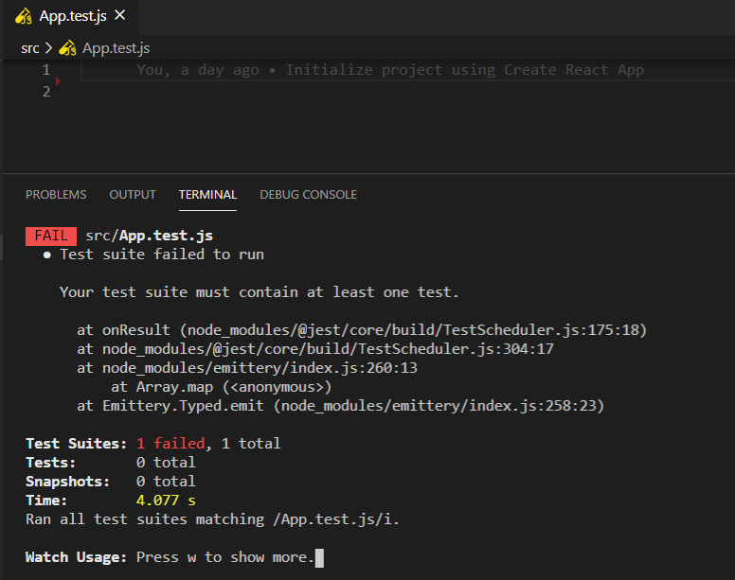
Rules for testing
All test files must contain at least one test. Otherwise they will fail:
Notes:
Show the structure of a test file. Code live session;

Slide 23
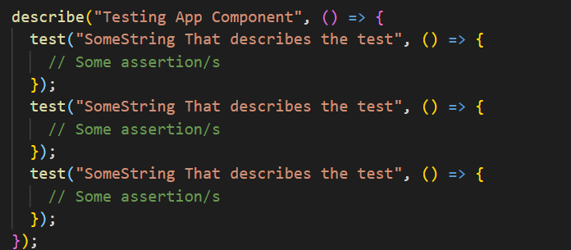
Rules for testing
Several tests might be grouped together under a describe.
Each test should at least have one assertion. Otherwise it will always pass.
This test suite will have 3 passing tests.
Notes:
Assertion is executable check for a property that must be true

Slide 24
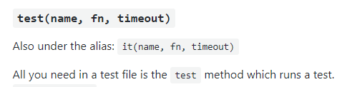
Rules for testing
Some frameworks use the method test to run a test, while others use it. Jest can take both, since it has been set as an alias for test:
Since Jest documentation examples use test, that is the one we are going to use.

Slide 25
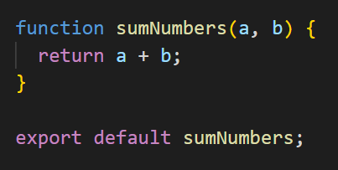
Rules for testing
The units to be tested need to be exported

Slide 26
Rules for testing
If you are exporting only one element, export it as export default <element> . For example, export only the sumNumbers function:
And to import it in another file, include the following in that other file:

Slide 27
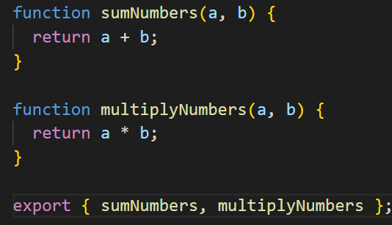
Rules for testing
You can export several elements if you don’t use export default. Instead, use export { }, with comma-separated names of what you are exporting:
You can also export at the beginning of the function or element declaration
And to import it in another file, you will need curly braces:

Slide 28
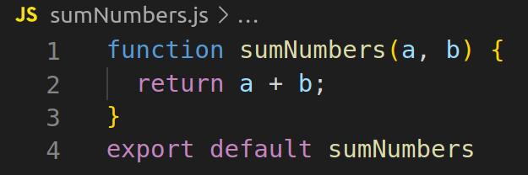
Setting up
Let’s say that we have the following function and its export:

Slide 29
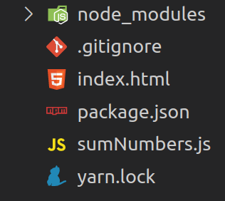
Setting up
The first thing we are going to need is to initialize a NodeJS project:
yarn init // fill in the options - leave them empty
yarn install
yarn add -D jest @types/jest babel-jest @babel/preset-env
touch .gitignore
echo “node_modules/” >> .gitignore
We will need Babel to compile ES6 imports, or we can use the .mjs extension. @types/jest it is for having intellisense for our Jest Methods
Notes:
-d for dev dependecy

Slide 30
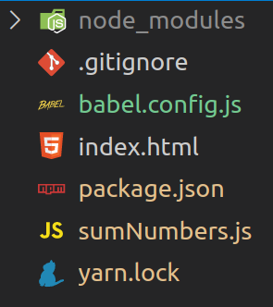
Setting up
Create a babel config file in the root:
touch babel.config.js
And add the following code:
module.exports = {
presets: [
[
'@babel/preset-env',
{
targets: {
node: 'current',
},
},
],
],
};

Slide 31
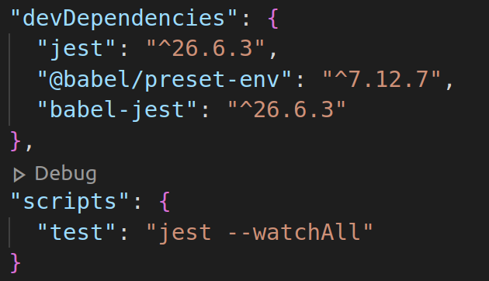
Setting up
Let’s add a script to test our application:
In package.json, add the following:

Slide 32

Setting up
With the script that we wrote, to run all the tests we need to run:
yarn test
If you want to run only one specific test and not the whole suite in your app, you can specify which tests using the name of the test file:
yarn test <name_of_the_test>
You don’t need to pass the whole name: App.test.js. You can omit the “test.js”. Also, it is not case sensitive. For instance, this works for App.test.js
yarn test app

Slide 33
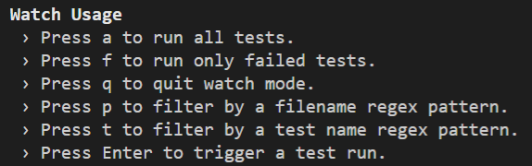
Setting up
Watch:
Watch reruns automatically the tests when we perform any modification.

Slide 34
Setting up
So far, we have:
Installed dependencies
Configured our compiler (Babel)
Created a script to run our tests in package.json
Now we can write some tests 🤩

Slide 35
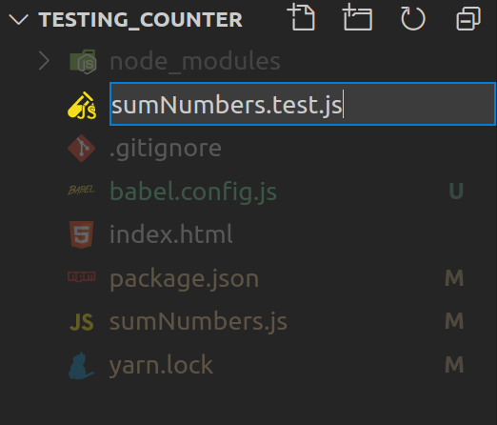
Let’s write some tests!
Let’s create a sumNumbers.test.js file in the same location:

Slide 36
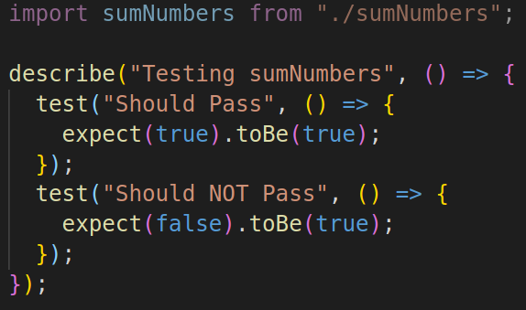
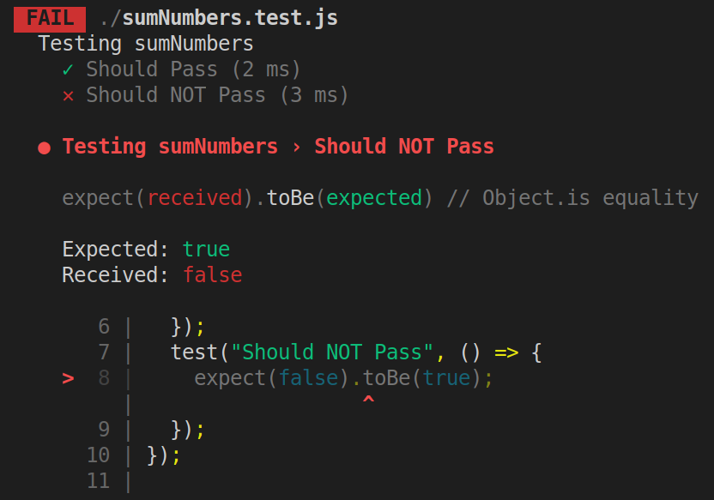
Let’s write some tests!
And let’s add some tests. As a tip, you should always start by making 1 failing test to ensure that the tests themselves are working.

Slide 37
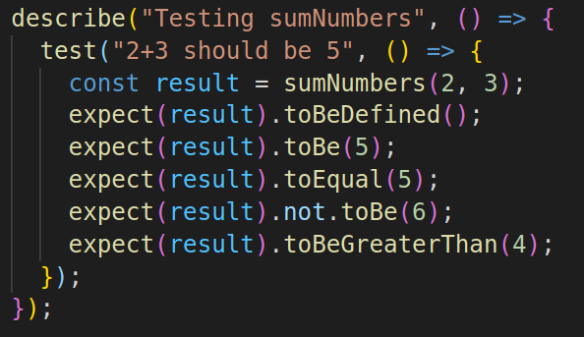
Let’s write some tests!
Let’s discuss the code: expect is a function that compares the value you are testing to an expected value. To customize the kind of test, you use a matcher (e.g., .toBe, .toBeFalsy, etc.). The matcher helps define what you are testing for. You can use one or more matchers. Some matchers take a parameter and others don’t. For instance, .toBe() can take a parameter, but .toBeFalsy() or toBeDefined() can’t.
The expect API of Jest provides lots of matchers, you can give them a look here.
Despite that you can use several assertions (expects) inside one test, that doesn’t mean that is the right approach. In this case, would had been enough with .toEqual(5)

Slide 38
Some notes regarding matchers
When using the expect API , you compare your result to a matcher. Among them, toBe, toEqual and toStrictEqual look very similar. Let’s look at the differences:
.toBe: Use .toBe to compare primitive values or to check referential identity of object instances. It calls Object.is to compare values, which is even better for testing than === strict equality operator. Two objects that look the same but are not the same reference, won’t pass a .toBe. MDN - Object.is().
.toEqual: Compare recursively all properties of object instances ("deep" equality). We can use it to compare two objects.
.toStrictEqual: Same as .toEqual but it also will be more strict with undefined keys and class instances. More details here.

Slide 39
Some notes regarding matchers
.toStrictEqual vs .toEqual:
Keys with undefined properties are checked. e.g. {a: undefined, b: 2} does not match {b: 2} when using .toStrictEqual.
Array sparseness is checked. e.g. [, 1] does not match [undefined, 1] when using .toStrictEqual.
Object types are checked to be equal. e.g. A class instance with fields a and b will not equal a literal object with fields a and b.

Slide 40
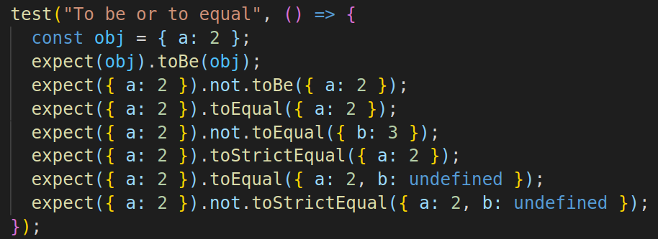
Some notes regarding matchers
Question: What will throw each of this assertions?
Answer: All of them will pass

Slide 41
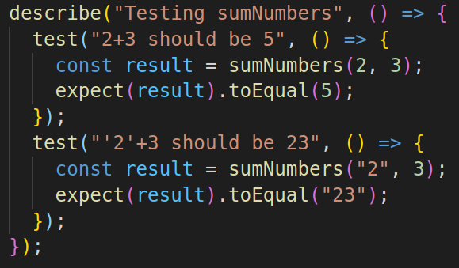
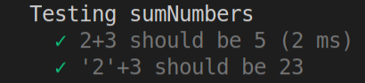
Let’s write some tests!
Question: Is the behaviour on the following test the one that you would expect from sumNumbers?
Here we have a design question: Should sumNumbers add one to the other if we receive a string?
What would happen if you call if with parameters with different types? Should you let it run? Should you throw an error? Return null?

Slide 42
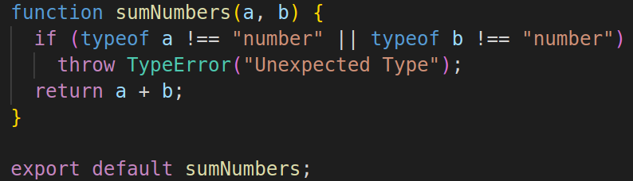
Let’s write some tests!

Slide 43
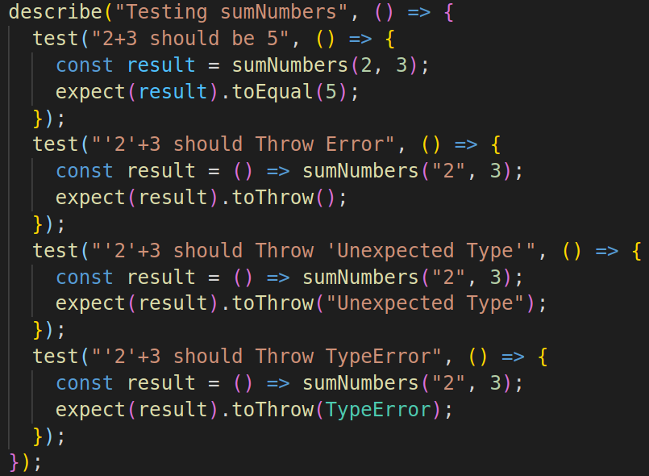
Let’s write some tests!
Testing Errors
Errors can and should be tested to.
To test an error, you need to wrap your function inside another one.
The 3 .toThrow will pass in this suite. Which one do you like better and why?

Slide 44
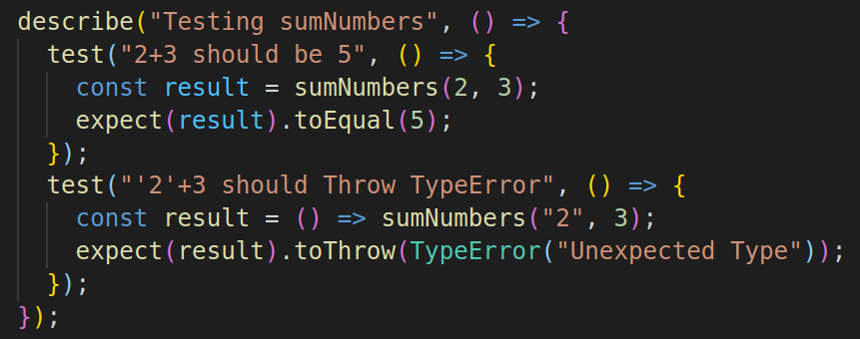

Let’s write some tests!

Slide 45
Recapping
We installed the dependencies and configured our environment. (jest, babel)
We created the right structure for our files (tests, imports, exports)
We learned about some of the matchers that you can use with expect
We learned how to write basic test suites. (Describe, test, expect and use some matchers)
We learned how to test for errors too.

Slide 46
Wrapping up
Motivation: automated tests save time.
Working in teams: guards your code from being badly modified by others, it shows intention of the functionality, so if it fails, it communicates it to the team mates.
When to stop:
You should have a test suite for the general cases.
You should have a test suite for the edge cases.
You should have a test suite for unintended use of your unit.
Should you throw an error? Which type of error?
Should you return null?
What is unintended use, an edge case, a general case, it is on you to define.

